Slide 1
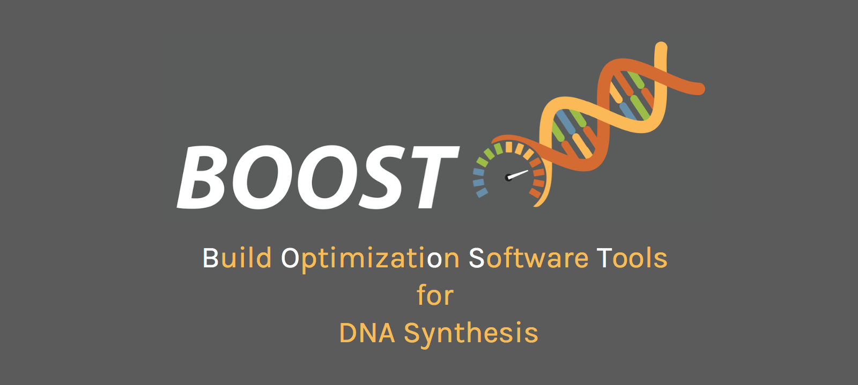
https://boost.jgi.doe.gov
Ernst Oberortner
eoberortner@lbl.gov
June 07th, 2018

Slide 2
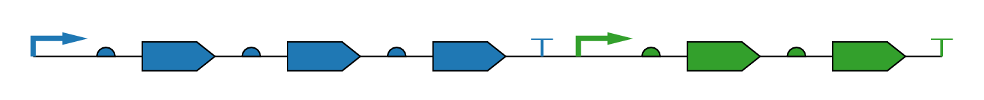
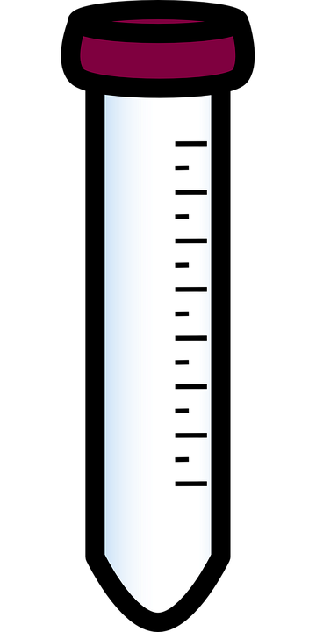
Design-to-Build Transition
Designed Construct
?
Physical Construct
6/7/18

Slide 3
DOE JGI – DNA Synthesis Community Science Program (CSP)
Synthesis call (~500 Kbp/project)
Biannual CSP: Jan and Jul
Large CSP: Mar (w/ sequencing)
FICUS: Mar (JGI-EMSL)
Review (2-3 months)
User Agreement
Approval by the DOE & JGI Director
Internal
Review
~3 Weeks
Scientific
Review
~3 weeks
Technical
Review
~3 weeks
Production
Initiation call: Defining the scope of work
Sequence Data Mining & Analyses
Construct
Design:
BOOST,
DIVA
Biosafety/Security Screening:
BLiSS
Synthesis,
Assembly,
QA/QC
Transcript
and
Metabolite
Analyses
USERS
14 Mbp/Yr
in total
6/7/18

Slide 4
Workflow: Design for Build
User
DNA Synthesis
Group
Vendor
Design
Specification,
Sequences
Design
Order sequences
Verify
Modify
Complex?
YES
NO
Synthesis
6/7/18

Slide 5
Workflow: Design for Build Problems
User
Increased
Cost
DNA Synthesis
Group
Vendor
Synthesis
Criteria?
Design
Specification,
Sequences
Design
Long
Turnaround Times
Order sequences
Verify
Hard to
track and
communicate
Modify
Complex?
YES
NO
Synthesis
6/7/18

Slide 6
Workflow: Design for Build
User
DNA Synthesis
Group
Vendor
Design
Specification,
Sequences
Design
Order sequences
Verify
Modify
Complex?
Synthesis
GOALS
Minimize cost and time
Maximize success rate
6/7/18

Slide 7
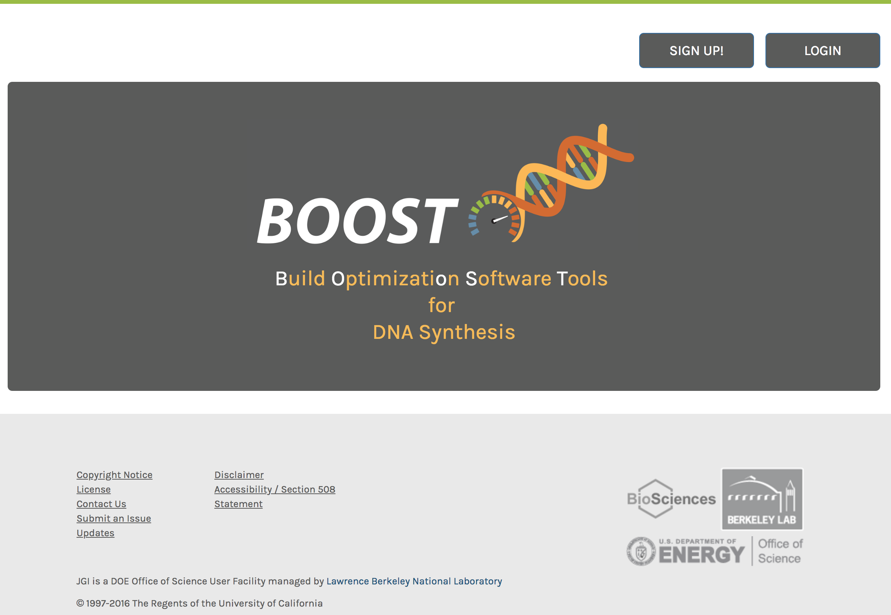
https://boost.jgi.doe.gov
6/7/18

Slide 8
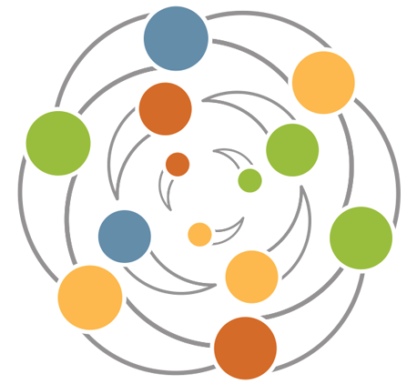

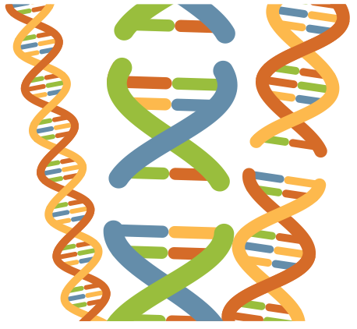
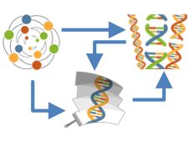
The BOOST tools
Juggler:
Reverse-Translation of Protein sequences into DNA sequences
Codon Juggling of protein coding DNA sequences (“CDS”)
Polisher:
Verification of DNA sequences against
DNA synthesis constraints and
sequence patterns (e.g., restriction sites, motifs)
Modification of protein coding DNA sequences (“CDS”) in case of violations against DNA synthesis constraints
Partitioner:
Partitioning of DNA sequences that exceed the maximum length of DNA synthesis
Workflow Manager:
Fusion of Juggler, Polisher and Partitioner
6/7/18

Slide 9

Example: DNA synthesis and assembly of 5-gene pathway
non-clonal (<1.8kb)
Partition sequence
Verify every building block
API
complex region
Map complex regions onto sequence
Are there complex regions in modifiable sequence features (i.e., CDS)?
N
Output building blocks,
Report complex regions
Y
Modify complex regions
6/7/18

Slide 10
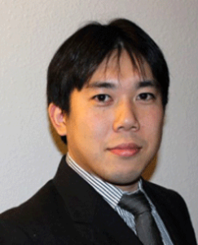
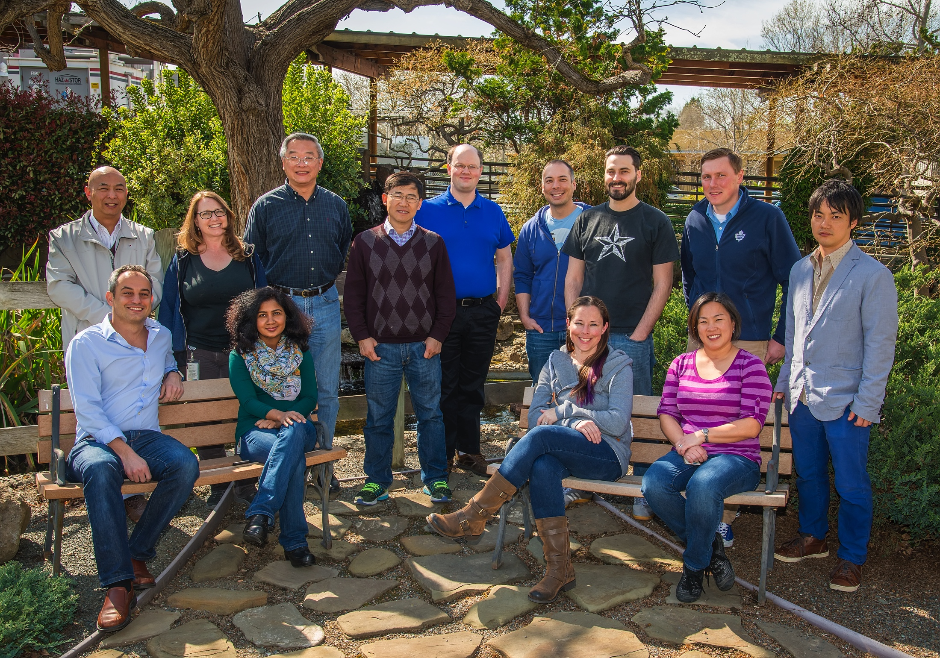





Acknowledgements
DNA Synthesis Group
Yasuo Yoshikuni
Nathan J. Hillson

Slide 11

Job Opening: DNA Synthesis Lead
https://lbl.referrals.selectminds.com/jobs/dna-synthesis-lead-849
Ernst Oberortner
eoberortner@lbl.gov

